Slide 1
Preliminary images for FOXSI-3 Silicon detector – Active region targets
Science call – Sept 26 2018

Slide 2
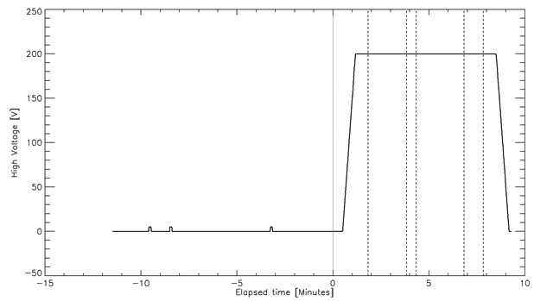
Timing (estimates)
One frame = 2 ms
HV started ramping up at +30 seconds after launch
Assume:
Observation started at +110 seconds after launch
Target exposure time:
1 (AR): 120 seconds
2 (NP): 30 seconds
3 (QS): 150 seconds
4 (AR): 60 seconds
On the plot, t=0 is launch
To select target, assume that we needed 4 seconds to point at the beginning of the target observation time and 2 seconds of uncertainty at the end ➔ Exclude the 4 first seconds and the 2 last seconds of each target from analysis
In the following, focus on active region = target 1 + target 4
launch
1 2 3 4

Slide 3
Silicon images with level1 data: number of events
For each frame, check the error flag. If error flag is 0, the event is a “good event”, otherwise it is a “bad event”.
 | Target 1 |  | Target 4
 | Good events | Bad events | Good events | Bad events
Det. Pos. 0 | 39 | 144 | 21 | 61
Det. Pos. 2 | 63 | 127 | 21 | 42
Det. Pos. 4 | 51 | 83 | 18 | 37
Det. Pos. 6 | 10918 | 11759 | 17482 | 7636
Detector 6 is noisy
Do we usually have that many “bad” events?

Slide 4
Silicon preliminary level 2 data: error flags
For each set of data, HV 200V.
 | Good | Bad | Flag 0 | Flag 1 | Flag 2 | Flag 3 | Flag 4 | Flag 5 | Flag 6 | Flag 8
Det. 0 | 147 | 548 | 175 | 369 | 417 | 0 | 50 | 410 | 383 | 0
Det. 2 | 195 | 433 | 110 | 262 | 357 | 0 | 24 | 292 | 244 | 0
Det. 4 | 165 | 300 | 40 | 128 | 230 | 0 | 15 | 168 | 129 | 0
Det. 6 | 91509 | 55672 | 7367 | 6746 | 23129 | 0 | 5394 | 26512 | 18715 | 0
Detector 6 is noisy
Do we usually have that many “bad” events?

Slide 5
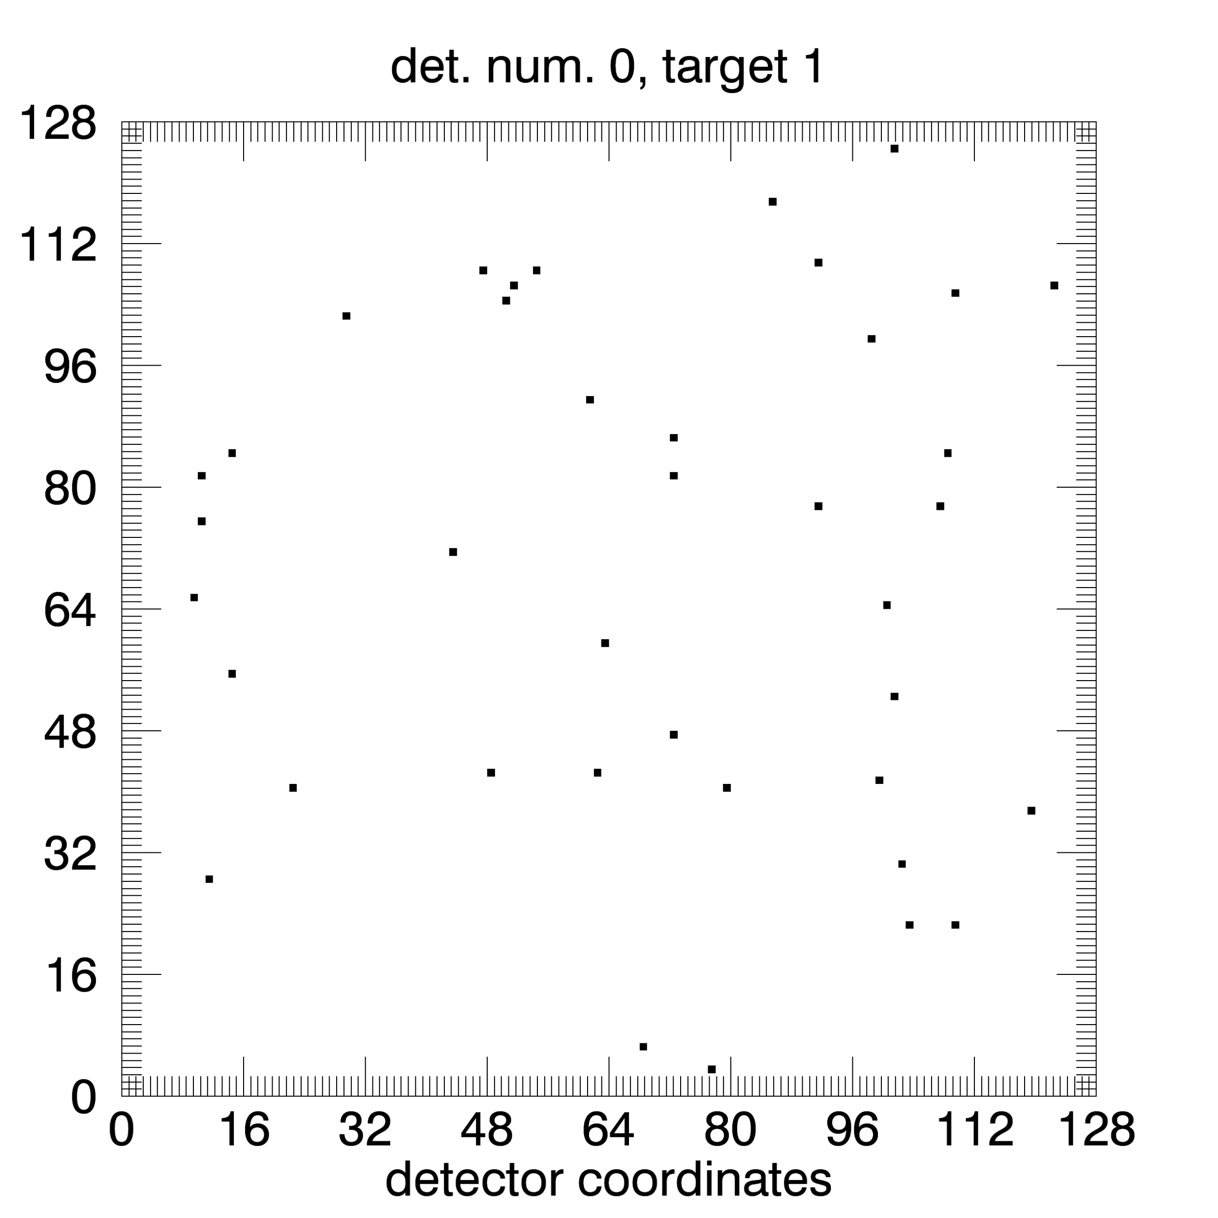
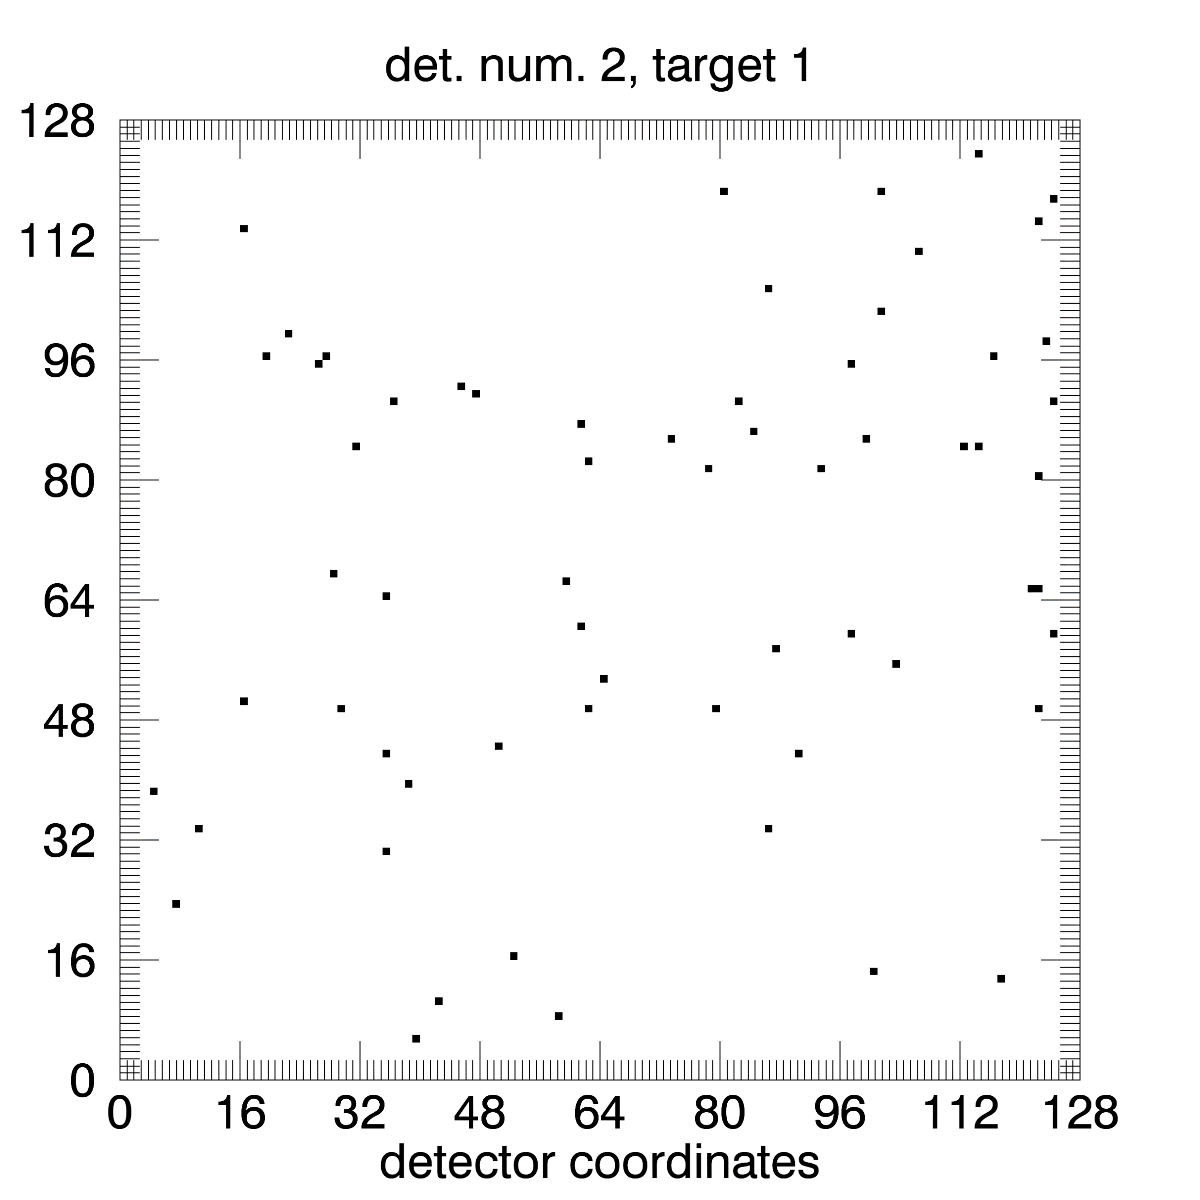
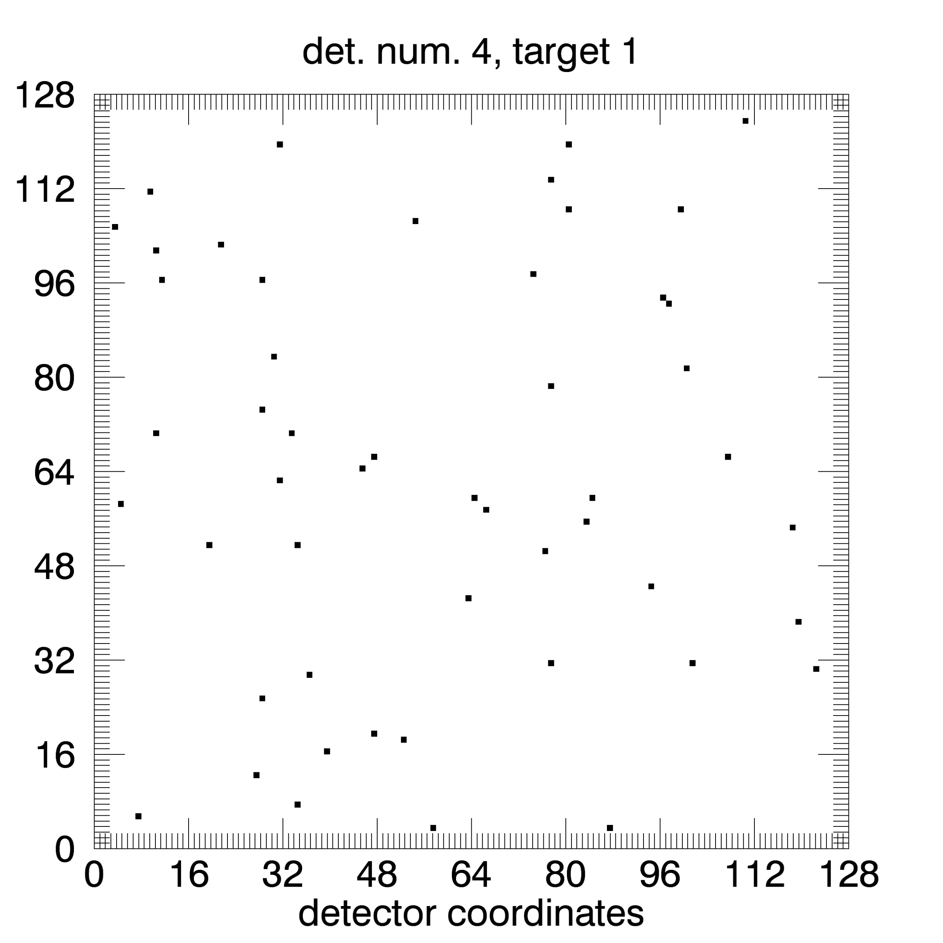
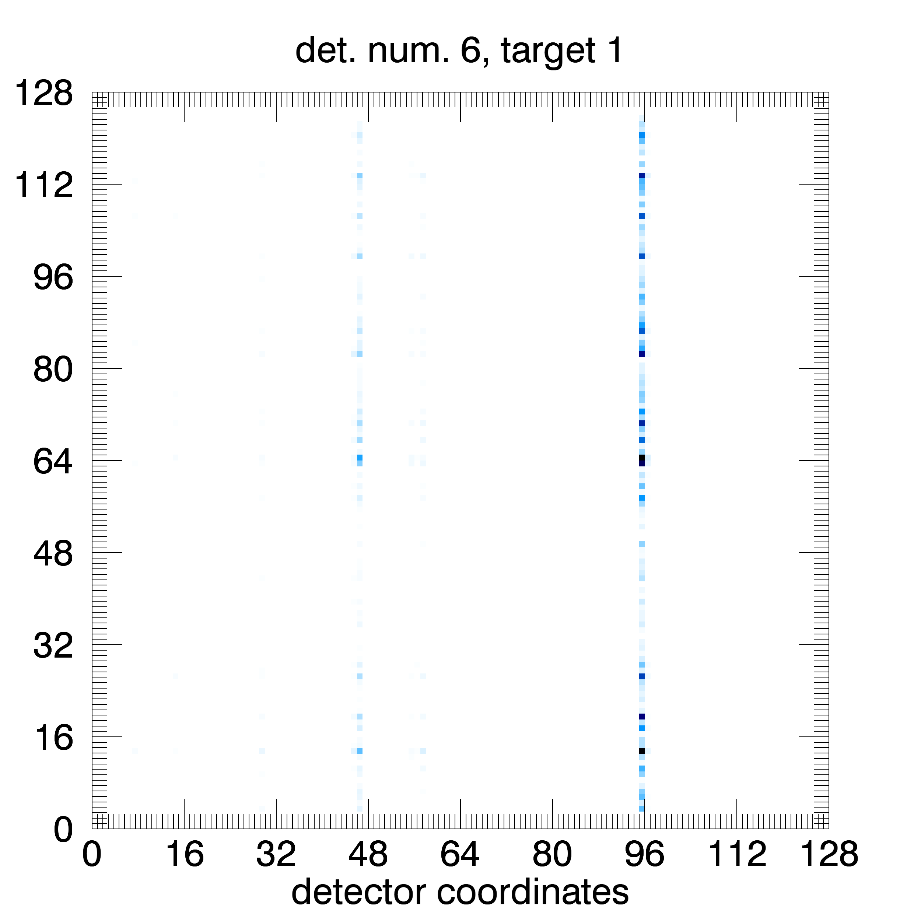
Silicon images in detector coordinates With level1 data
Target 1

Slide 6
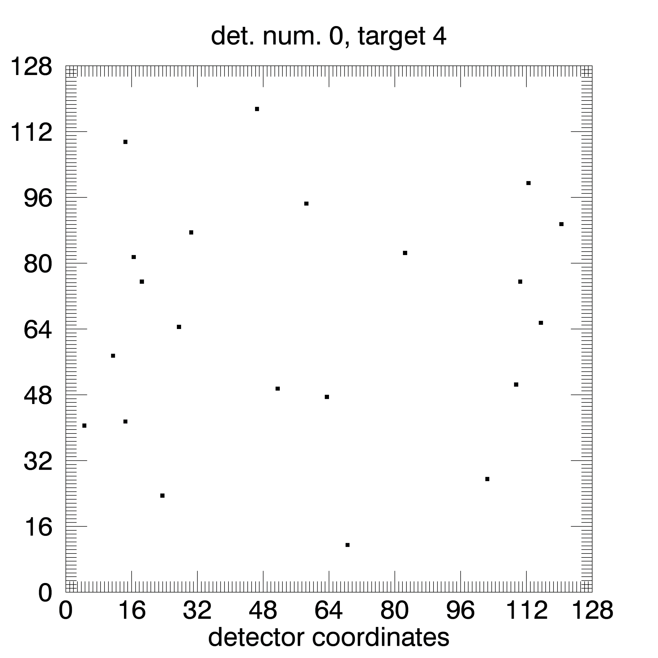
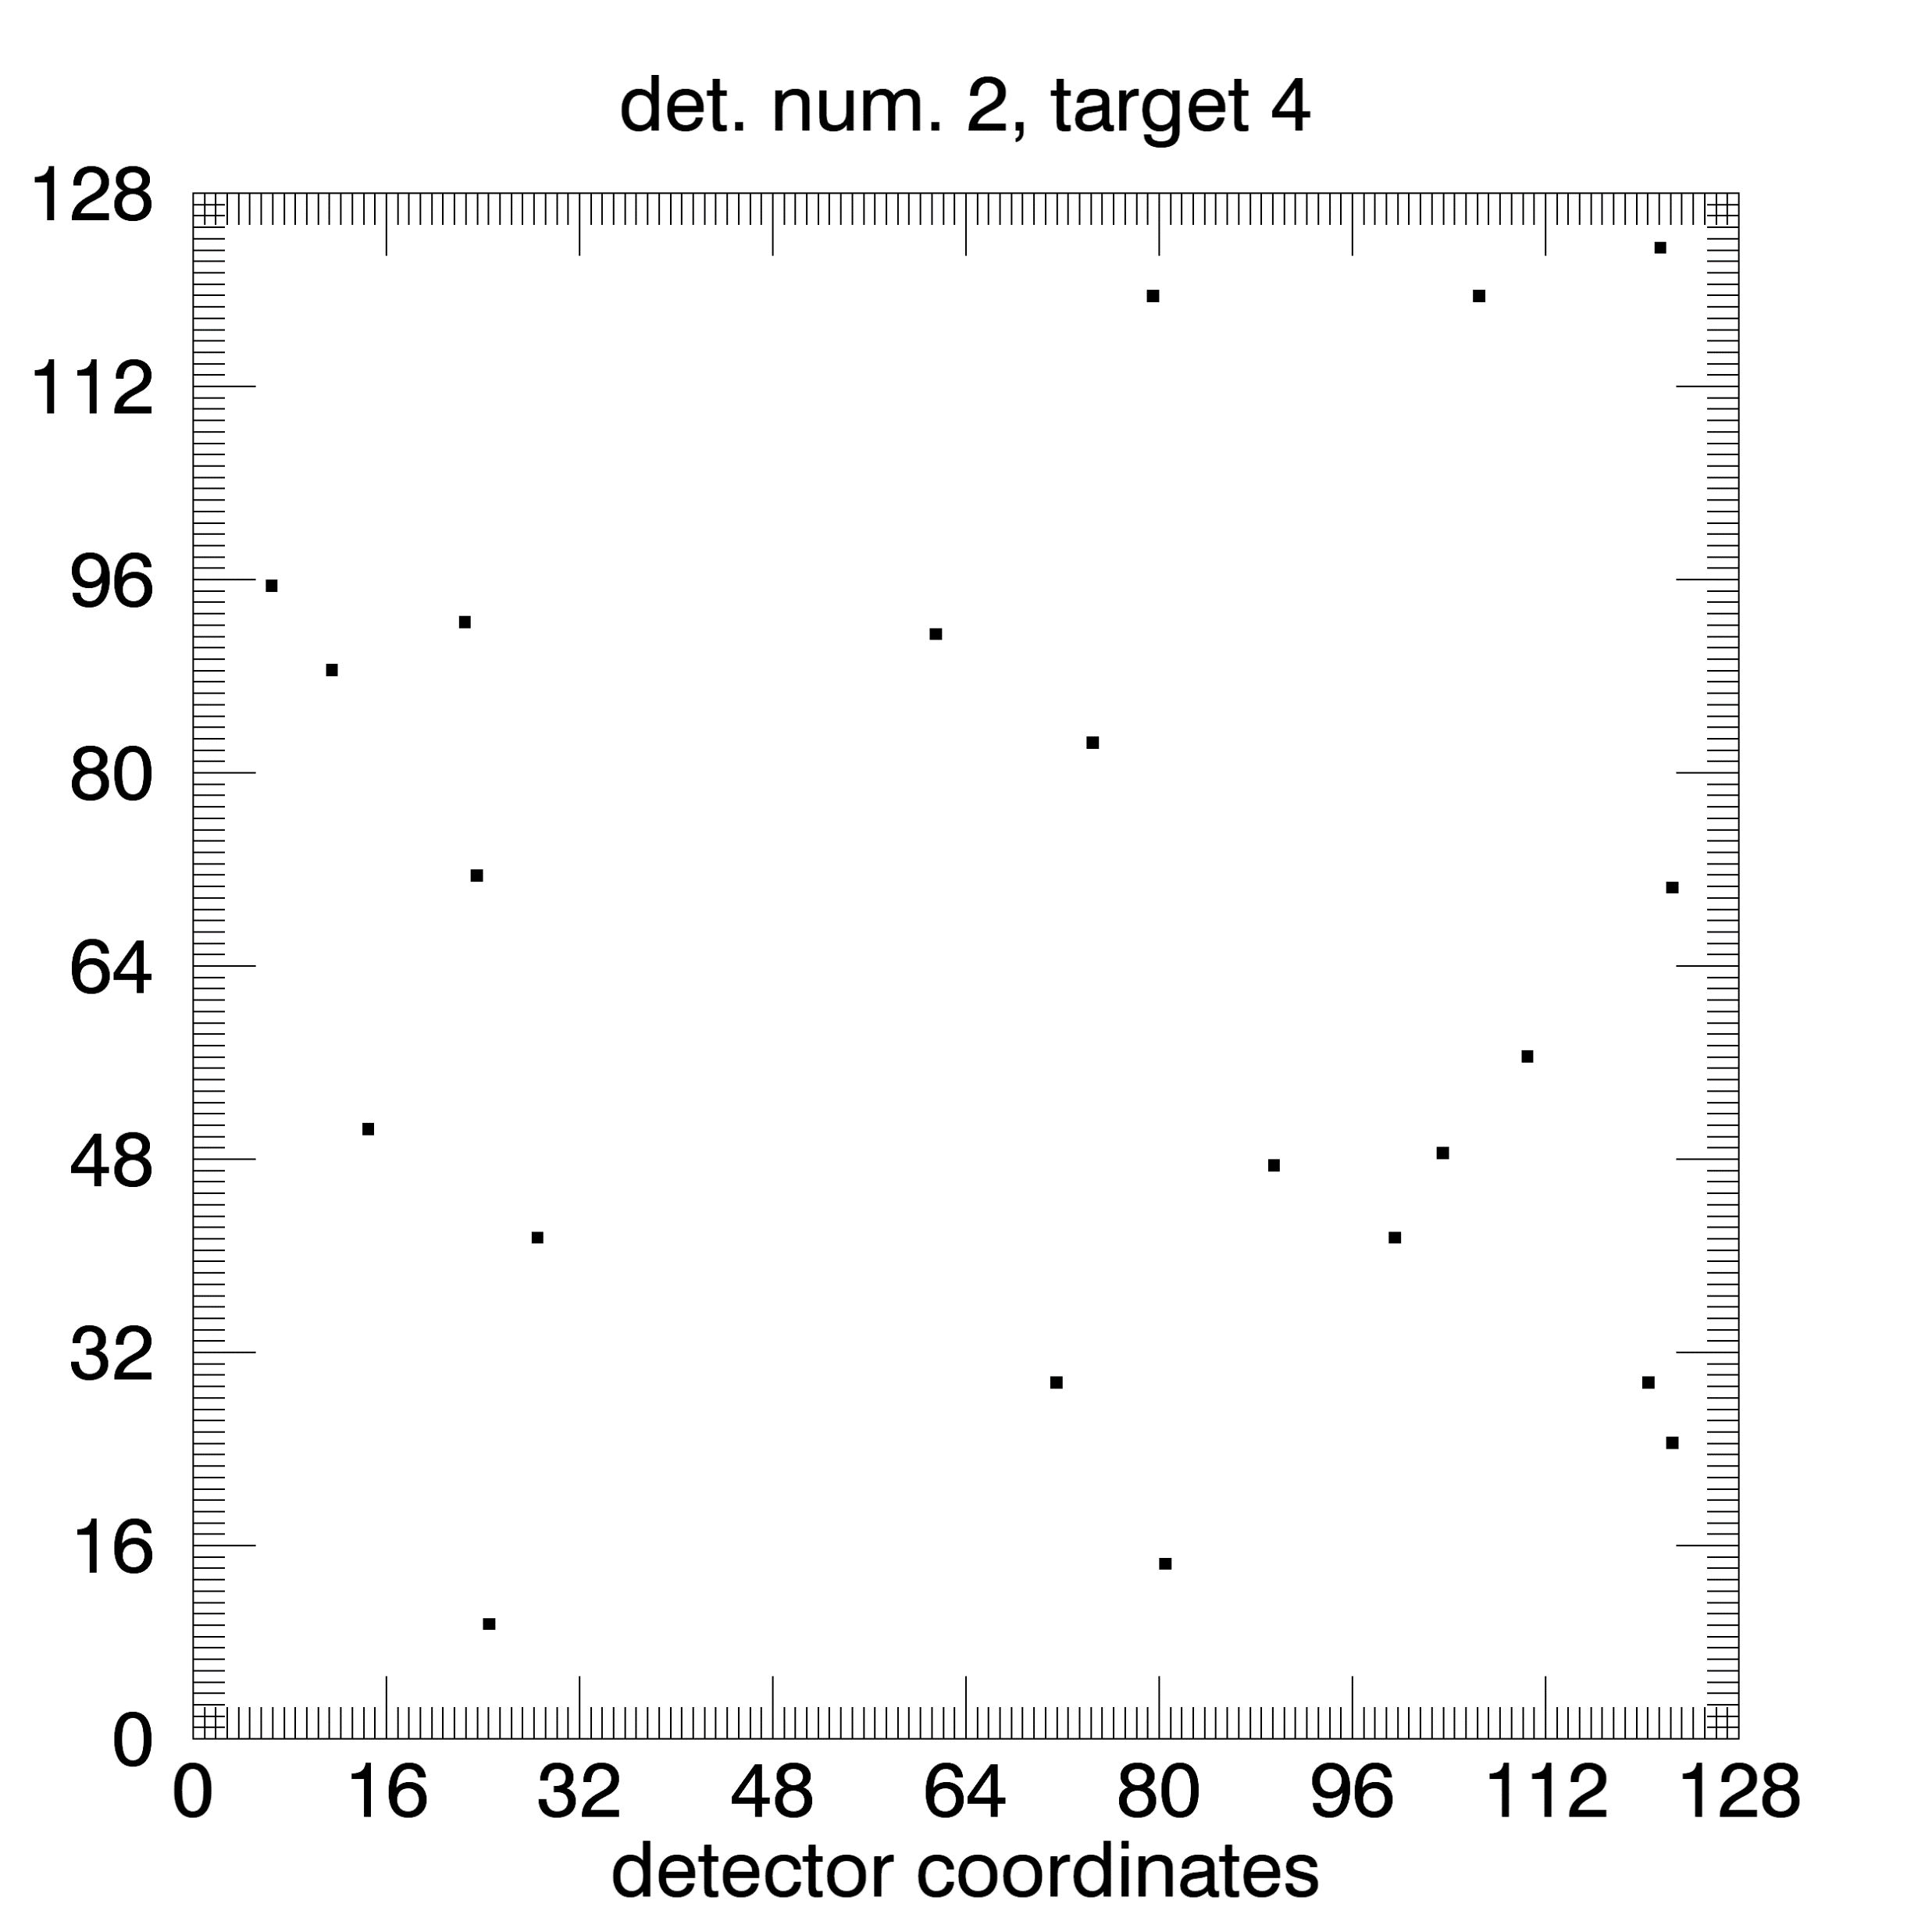
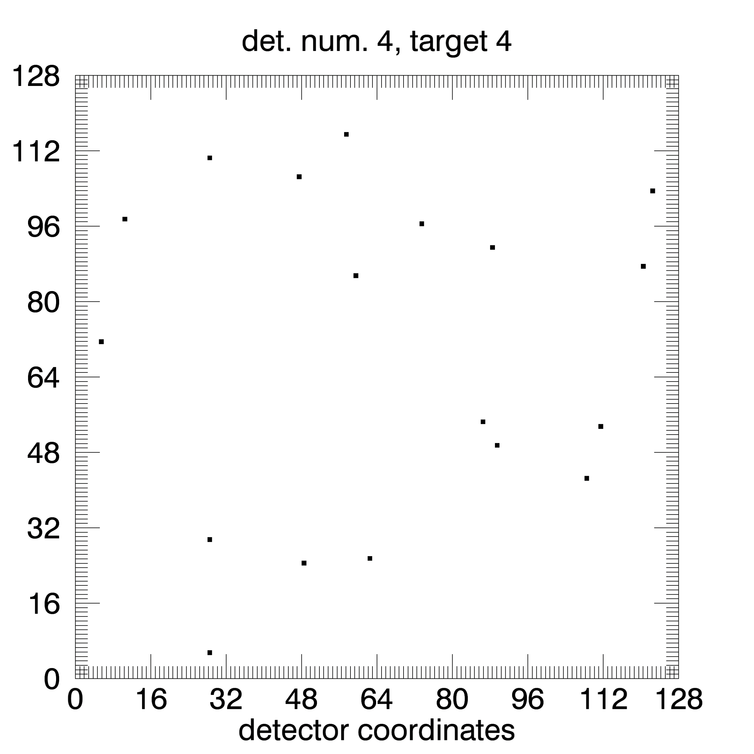

Silicon images in detector coordinates With level1 data
Target 4

Slide 7
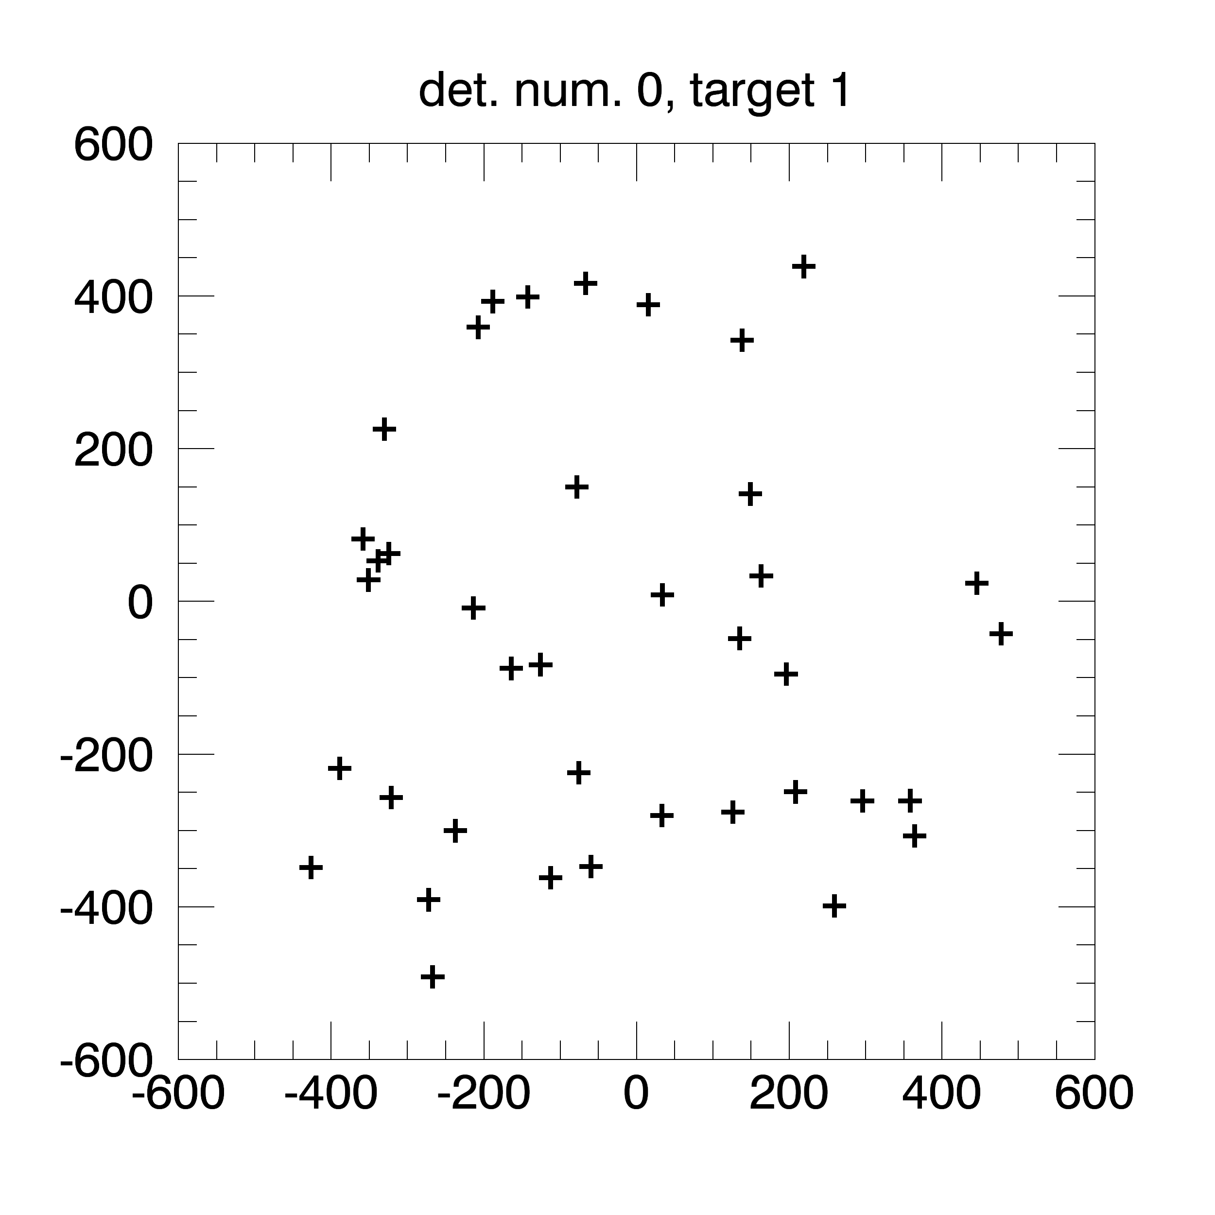
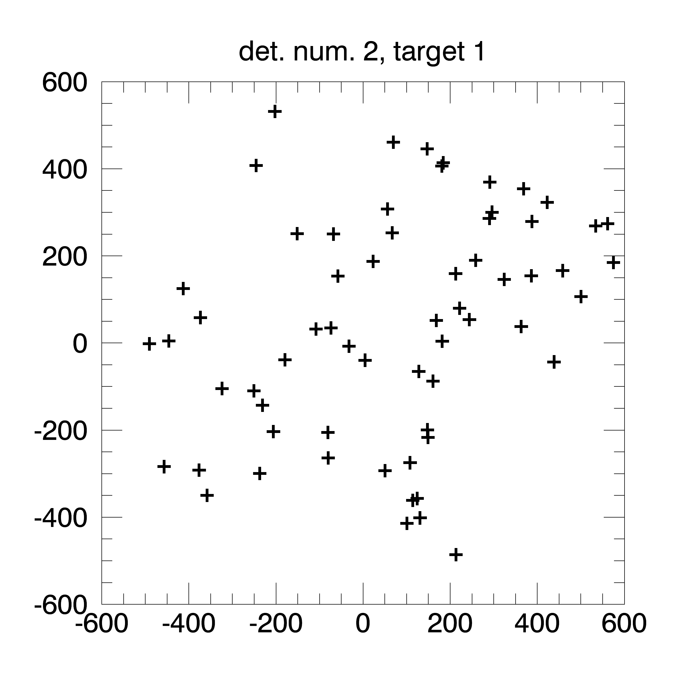
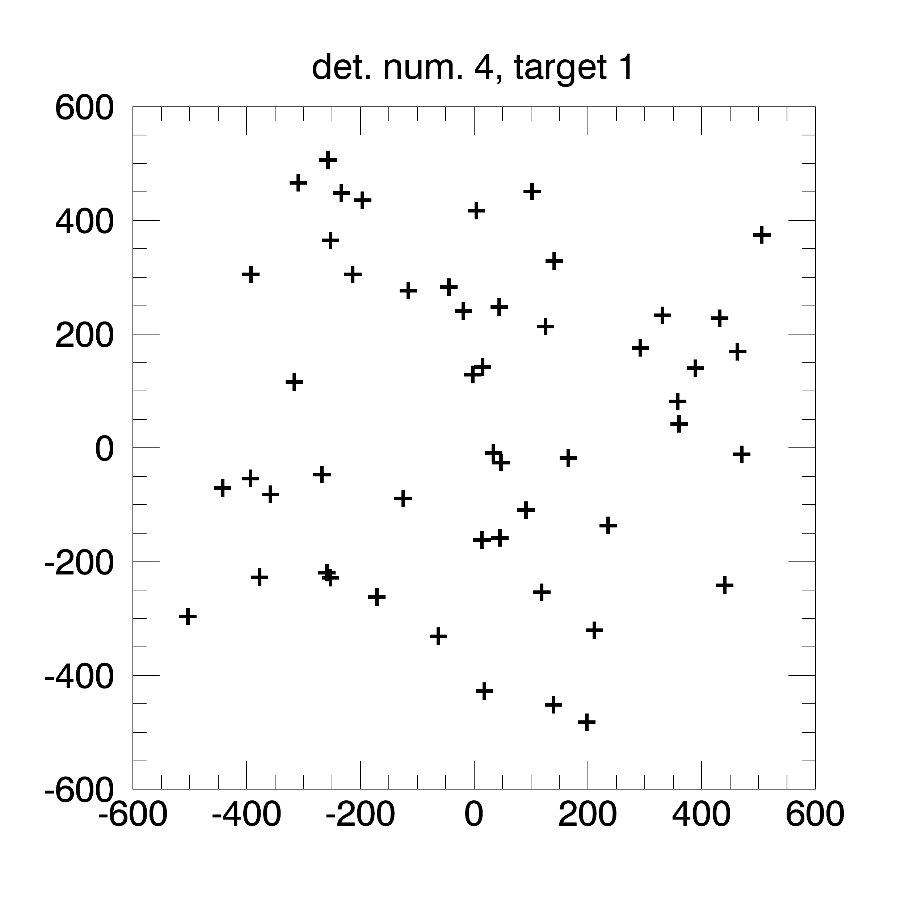
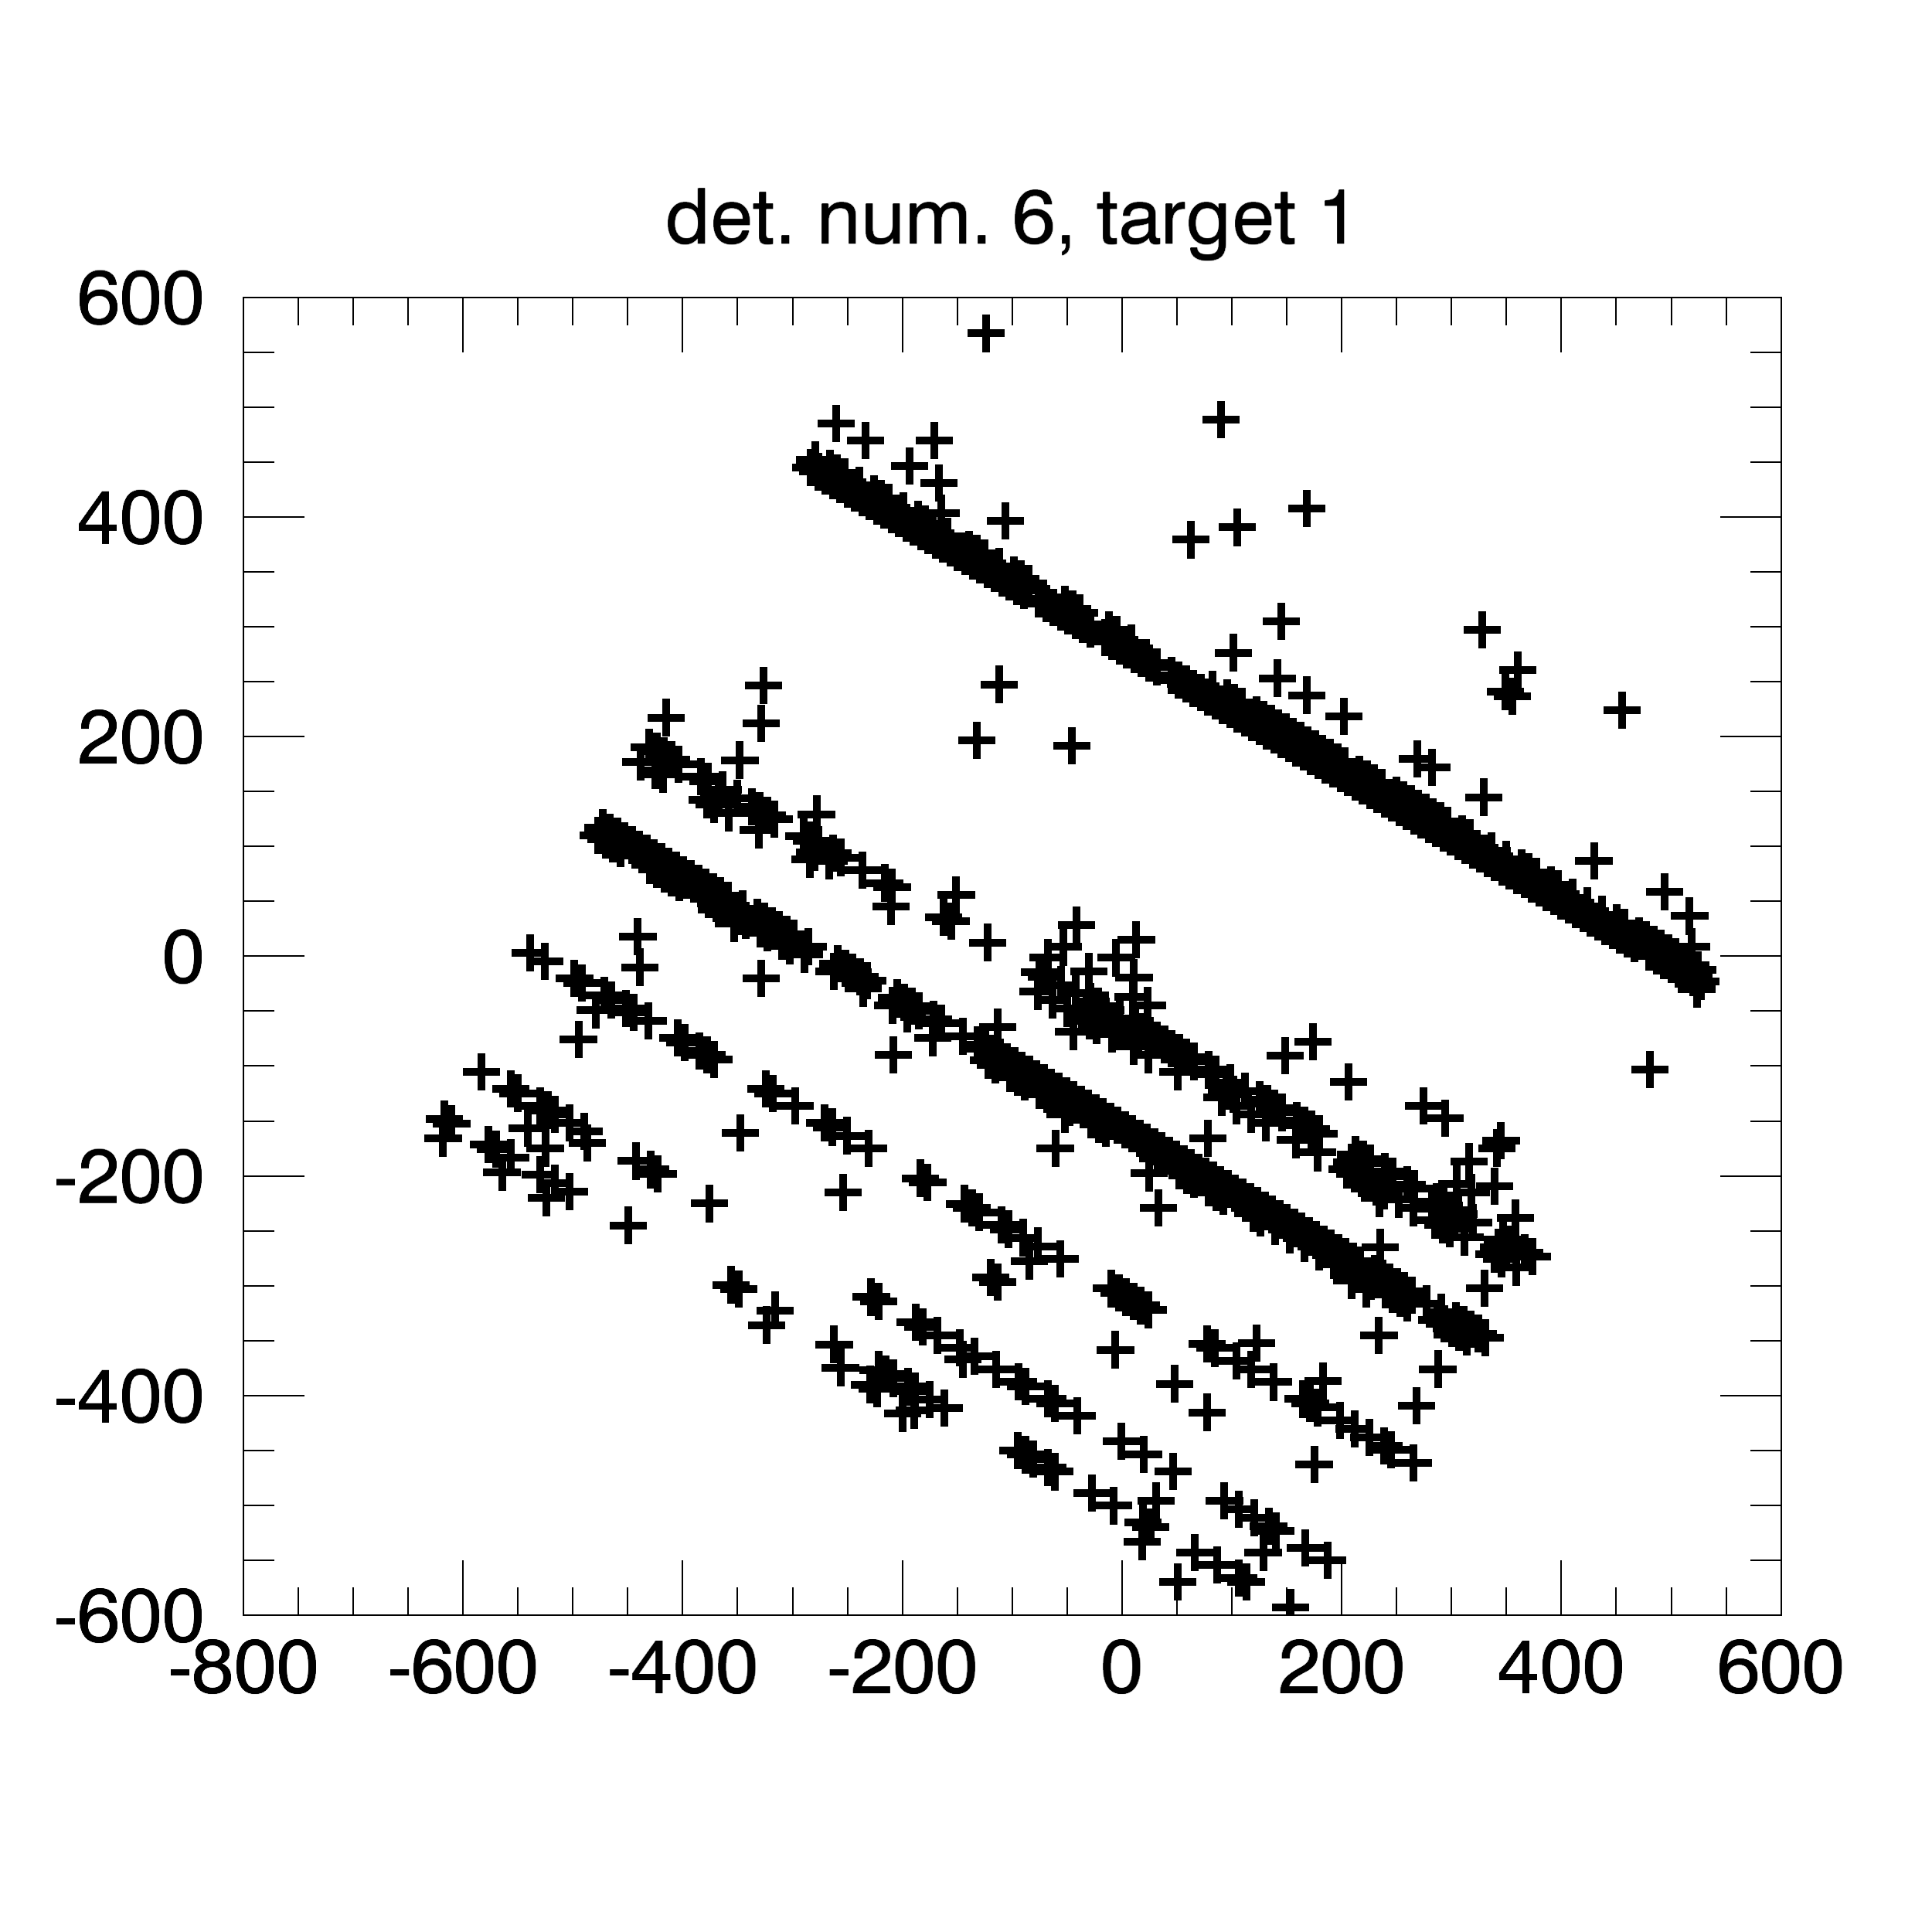
Silicon “images” in payload coordinates With level1 data
Target 1

Slide 8
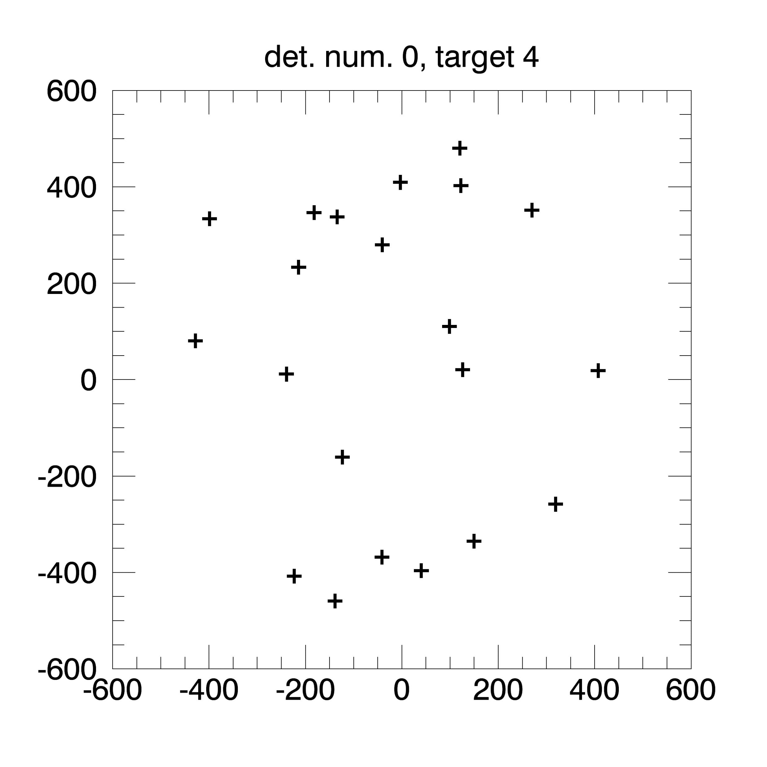
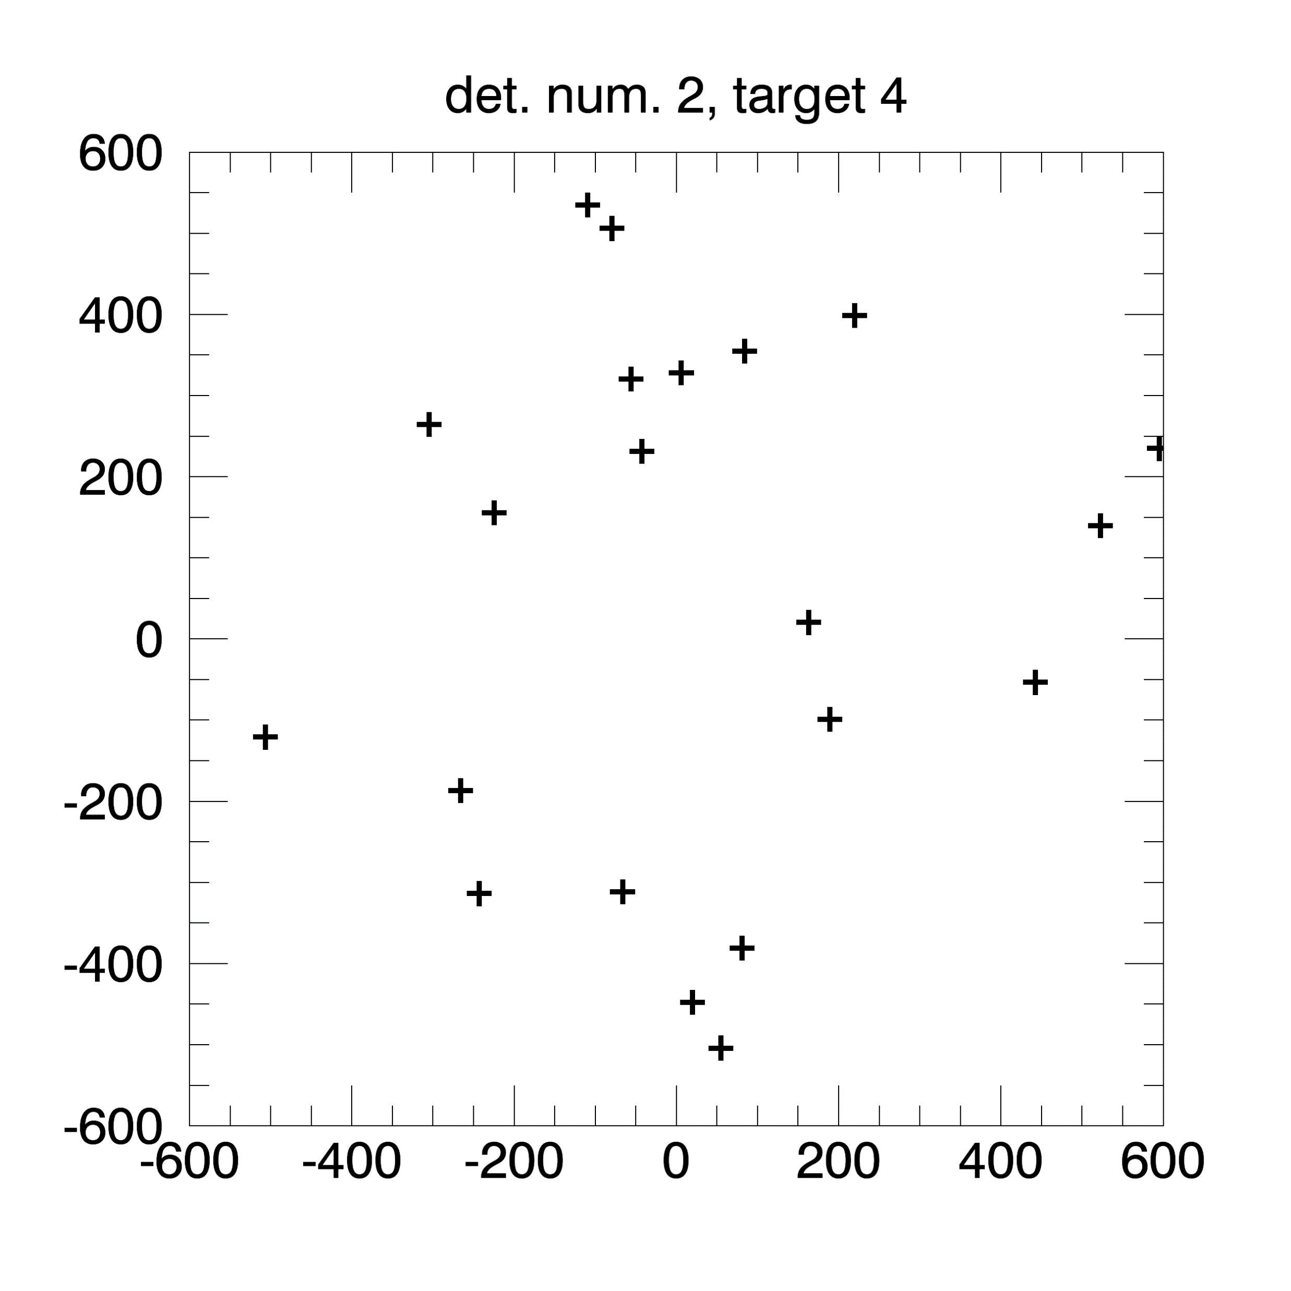
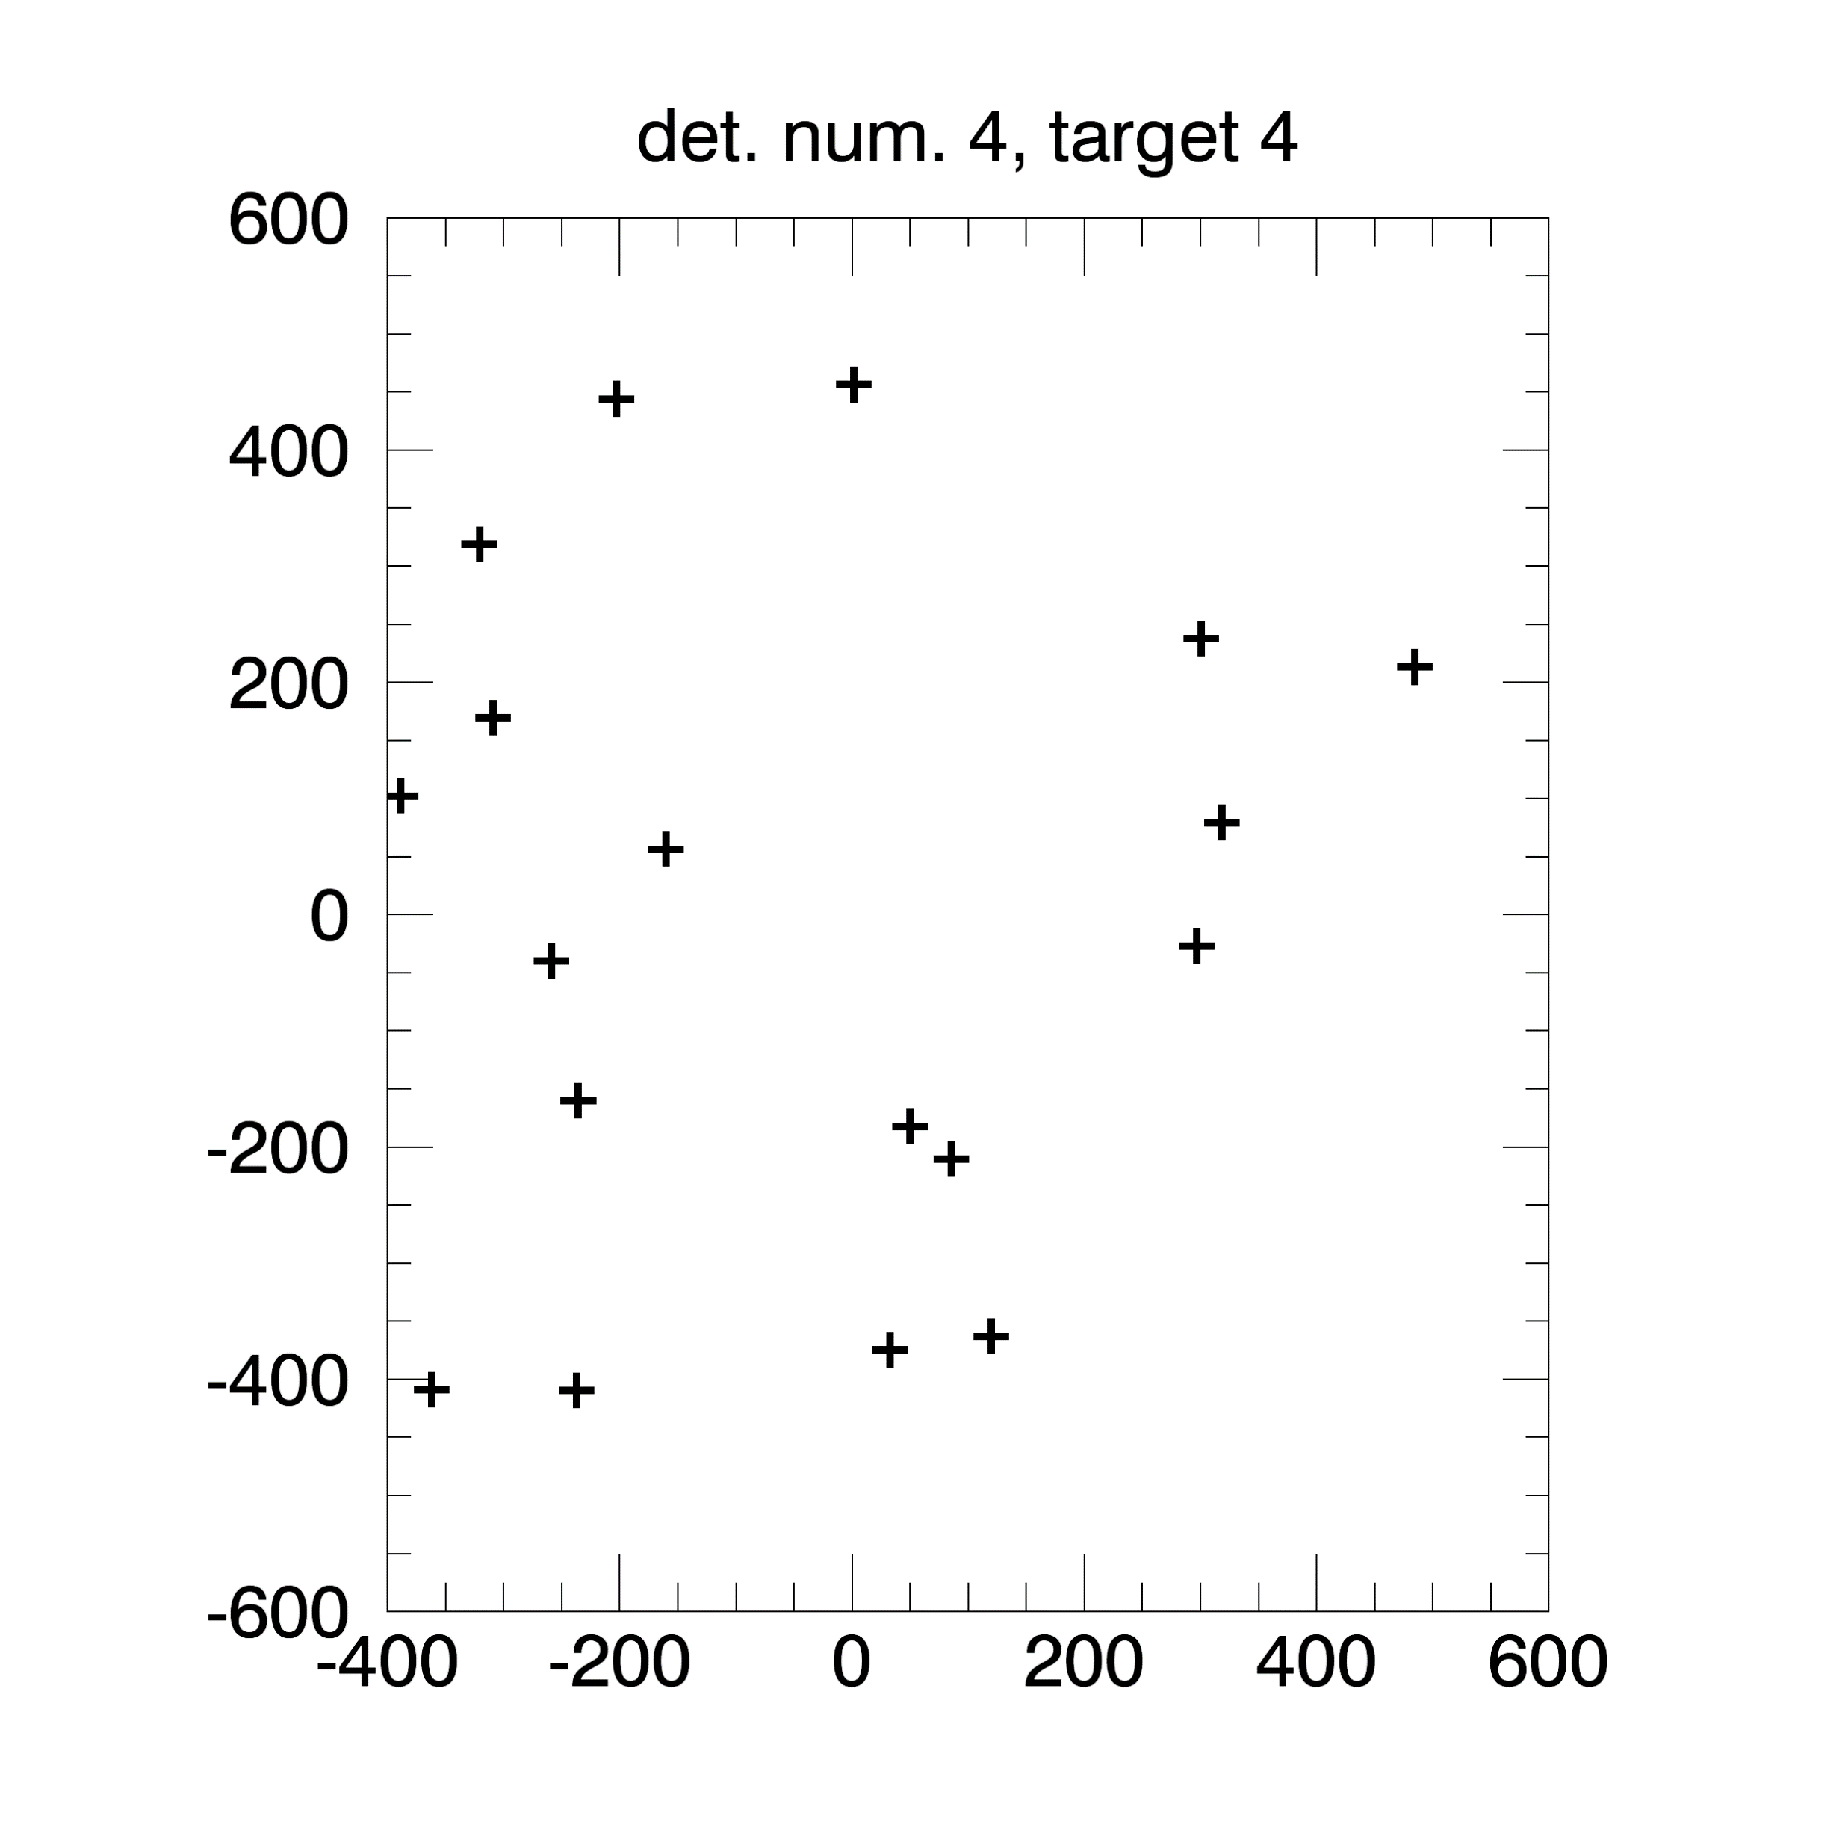
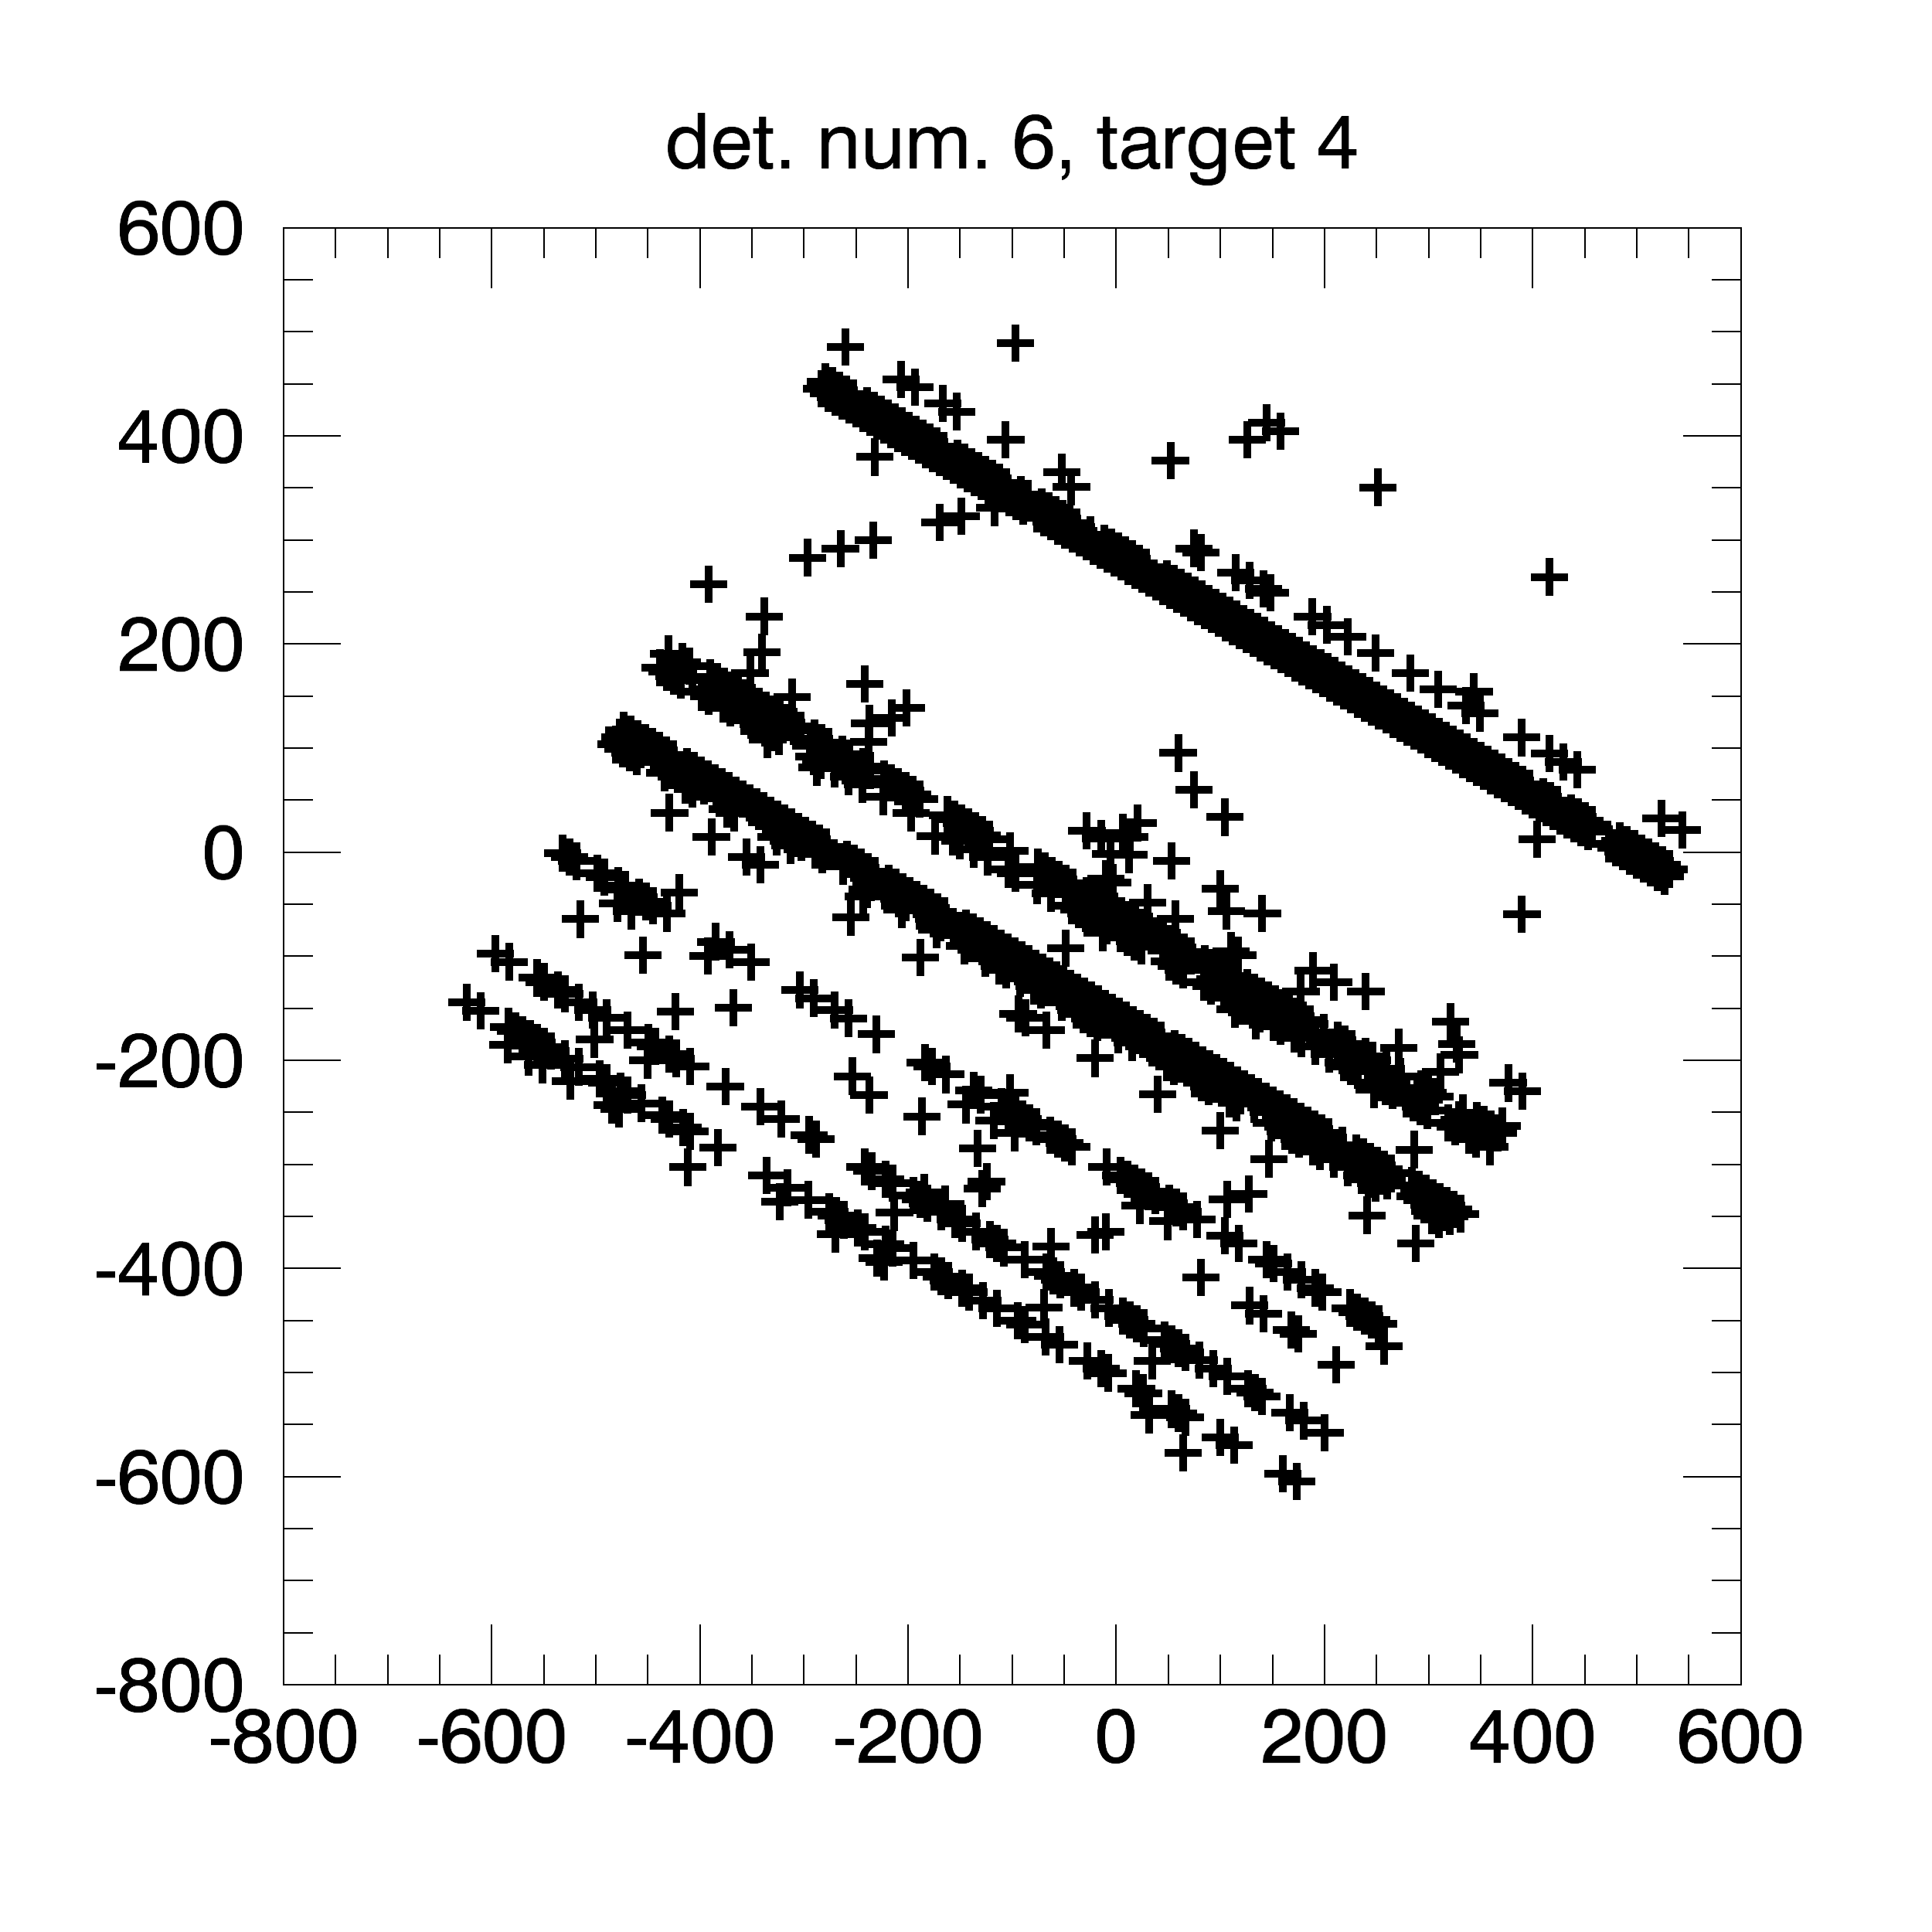
Silicon “images” in payload coordinates With level1 data
Target 1

Slide 9
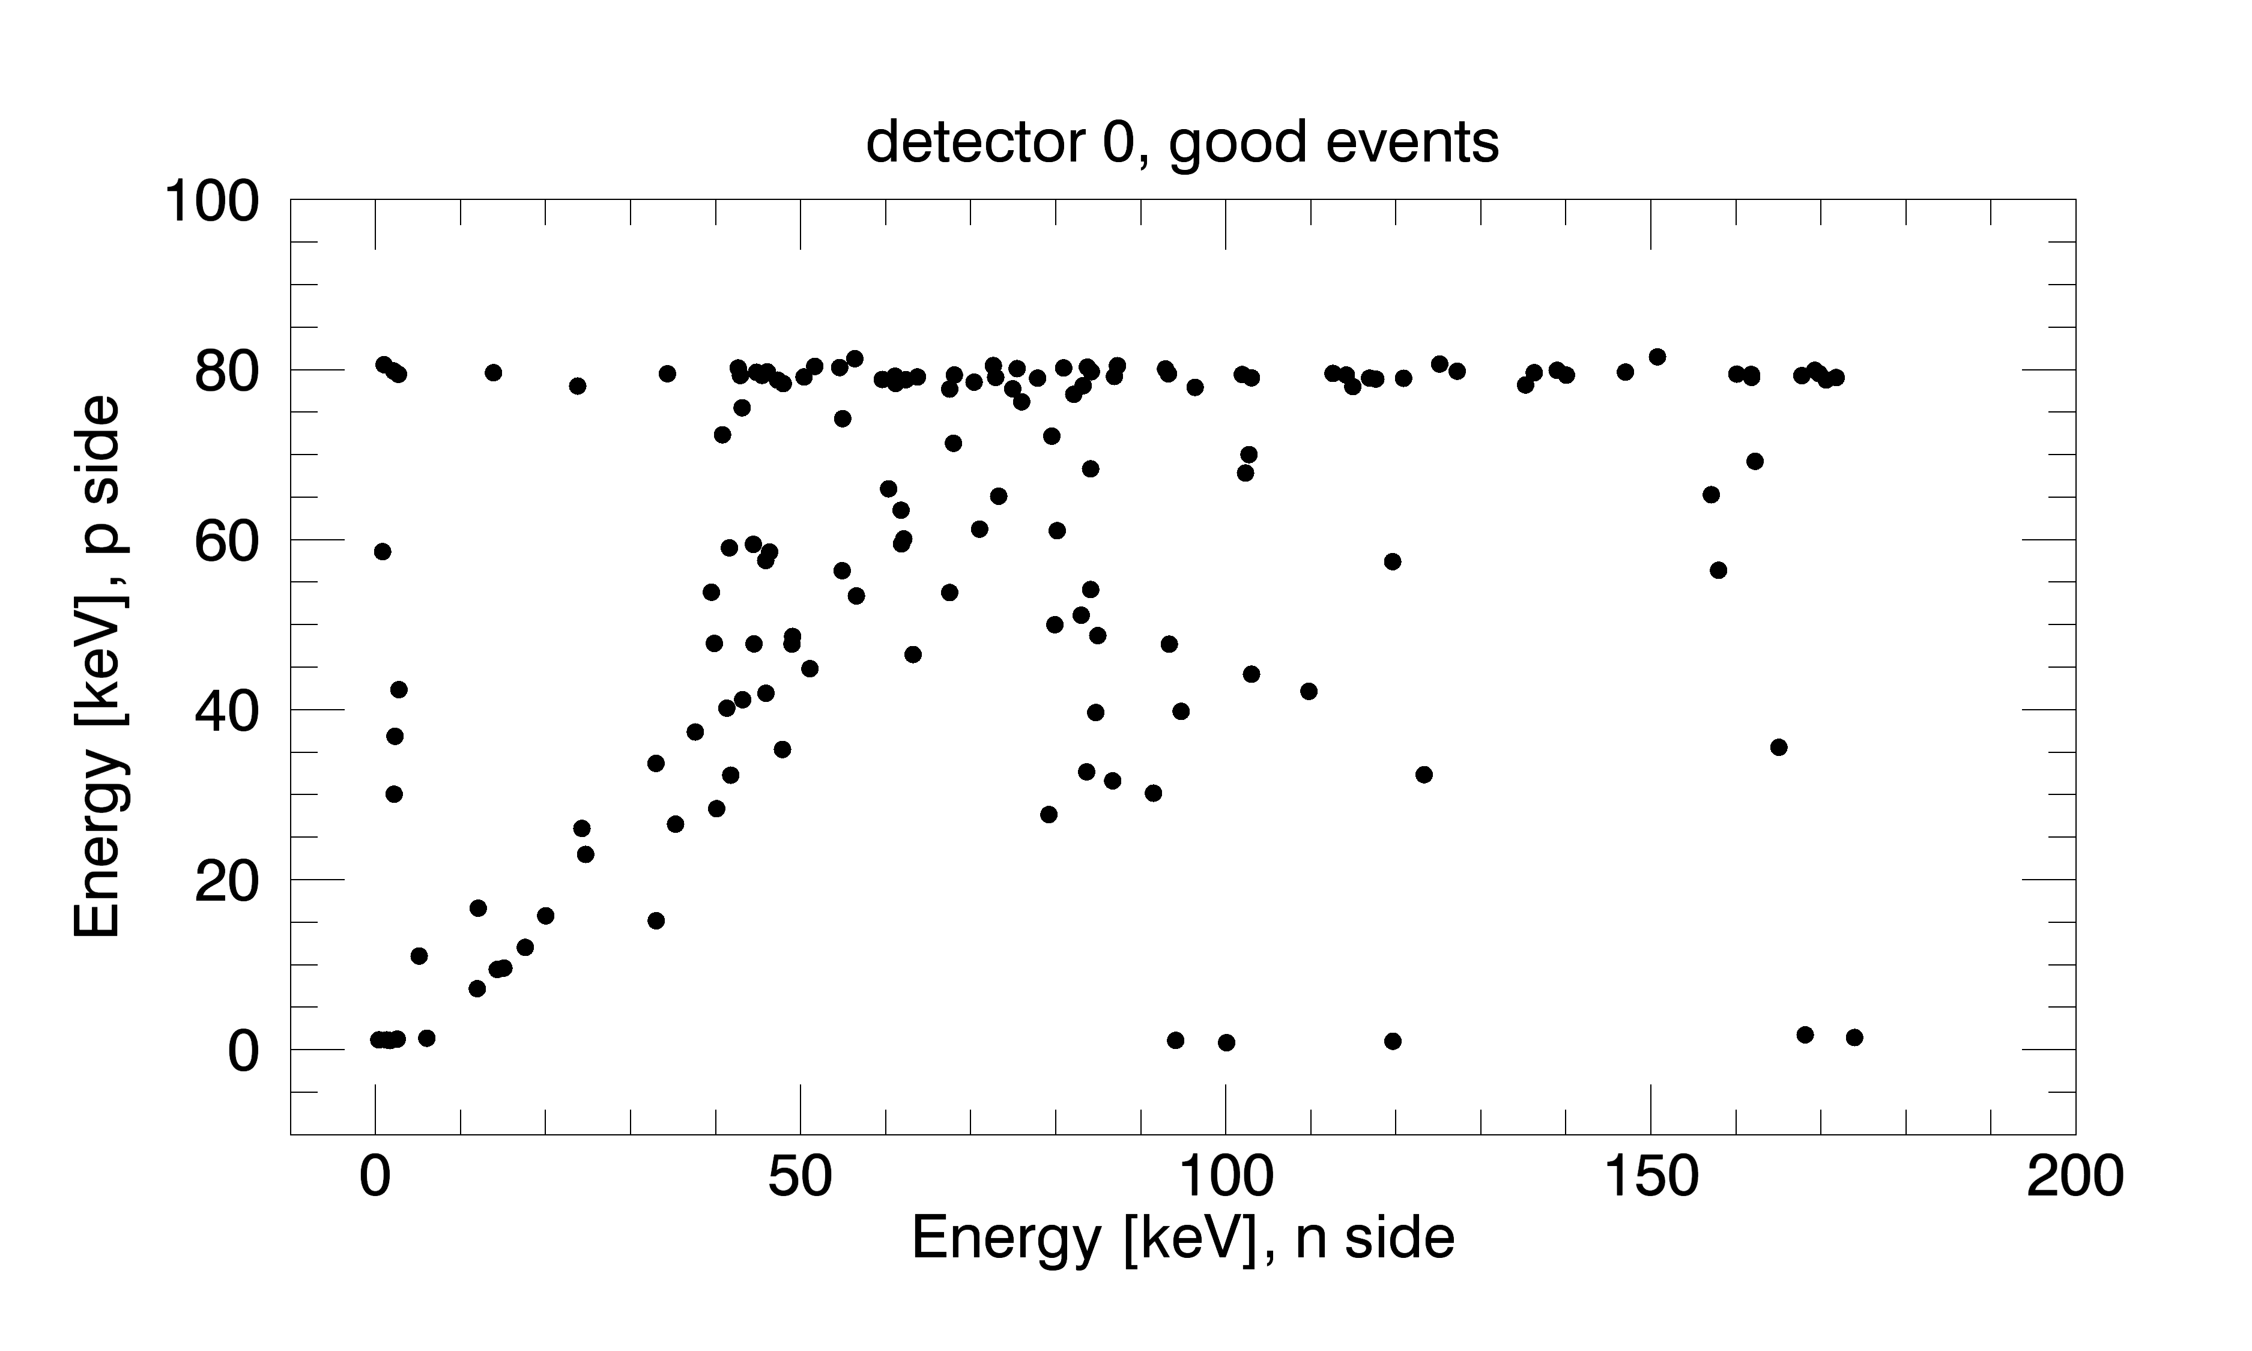
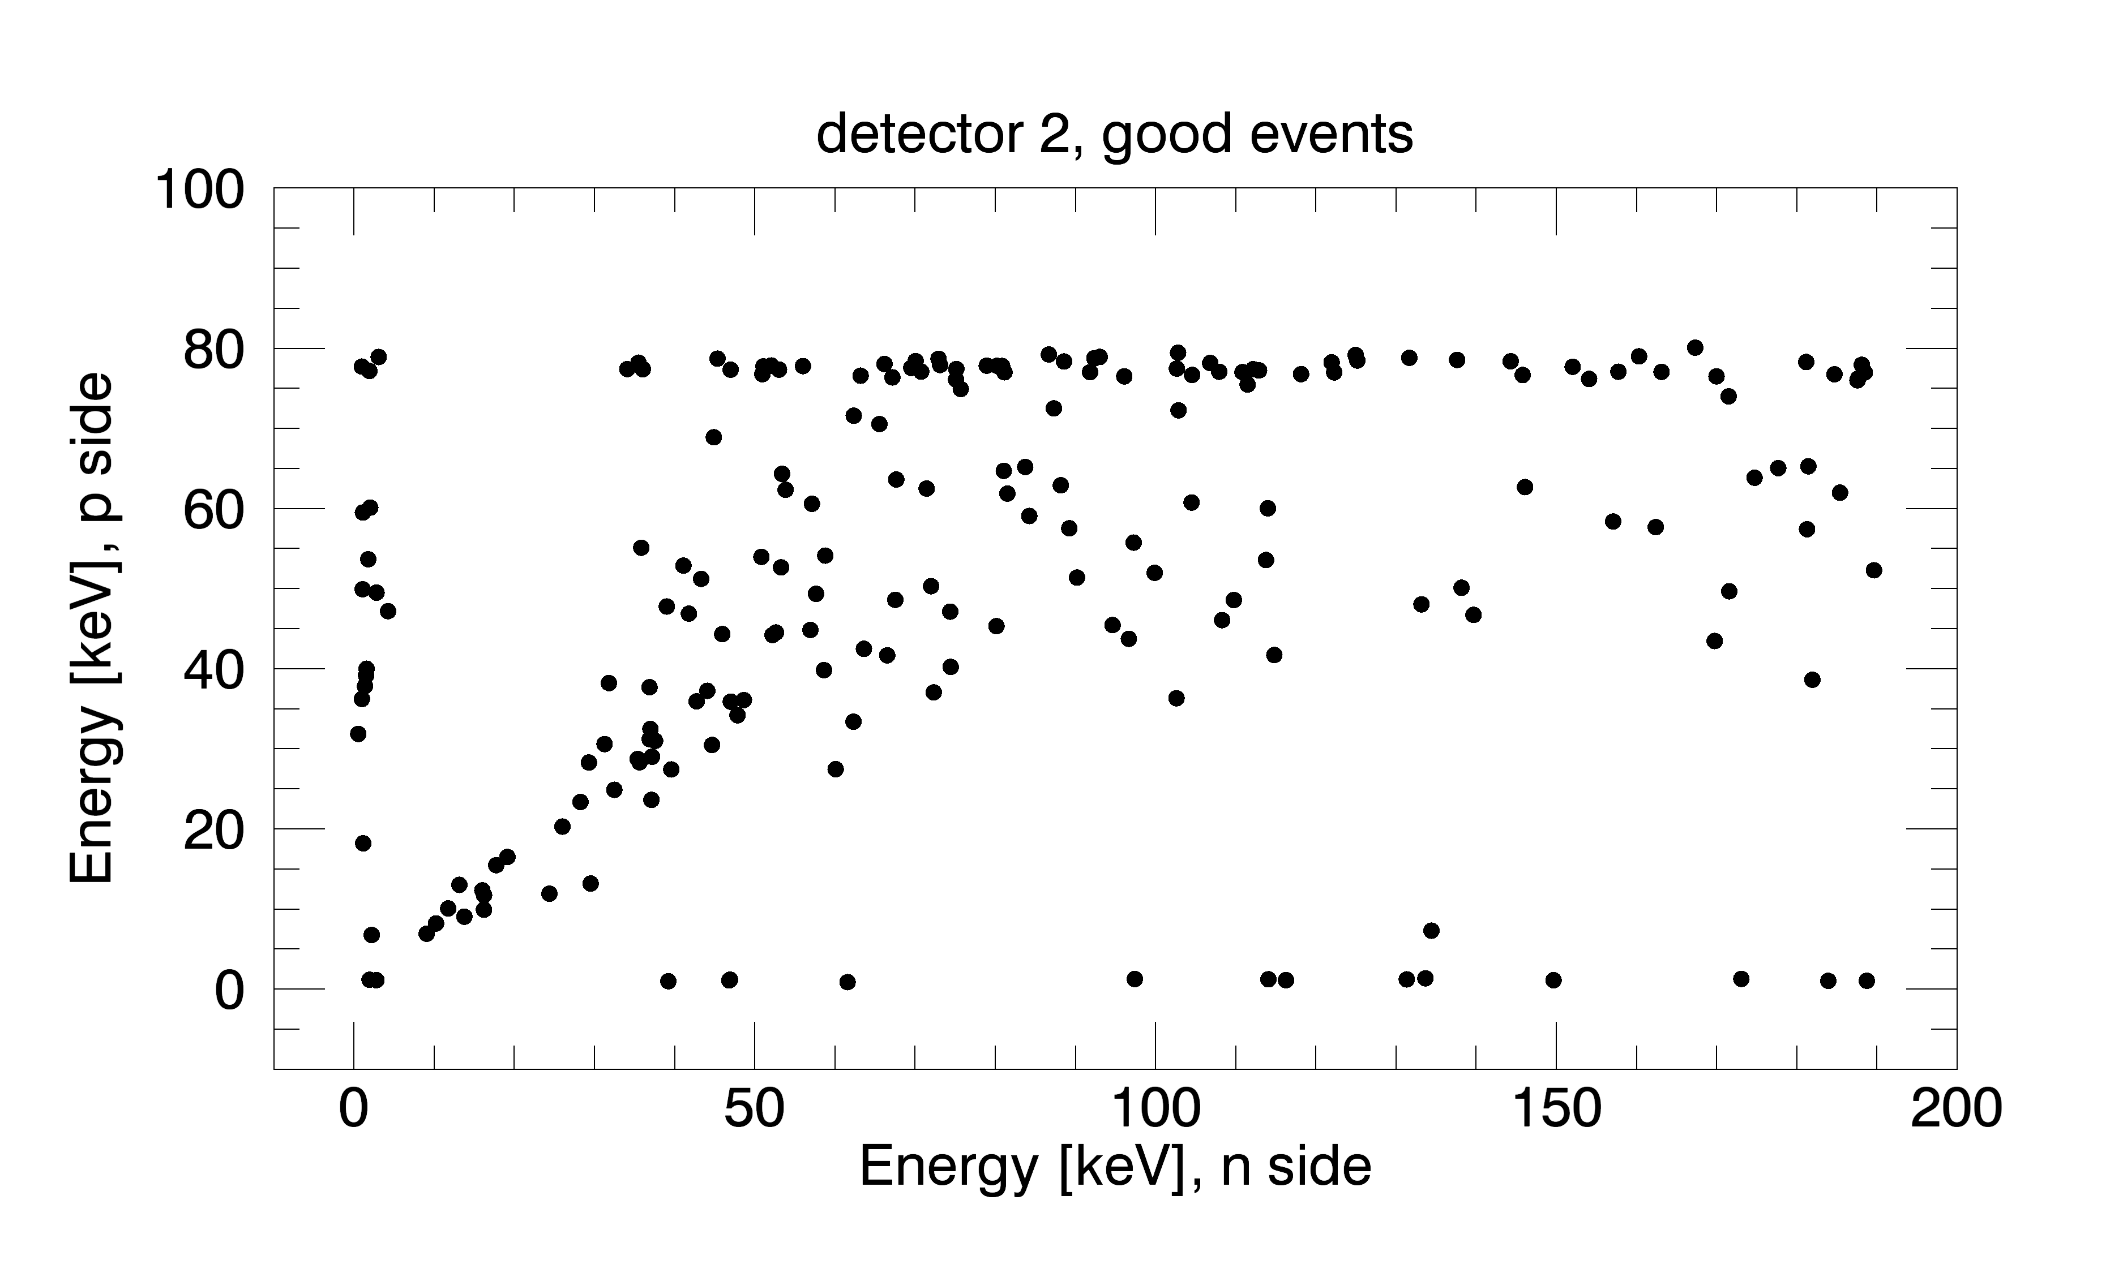
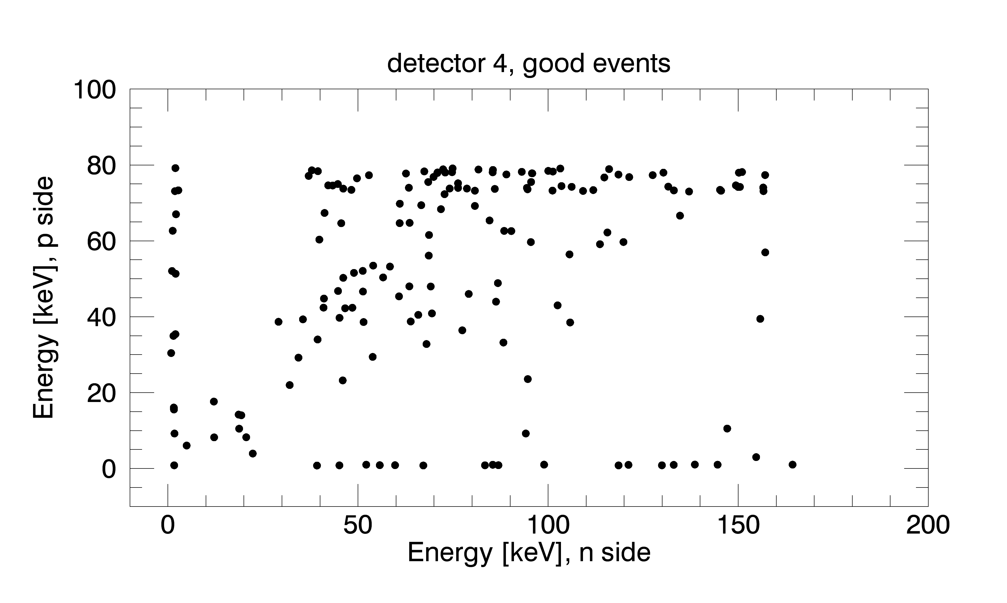
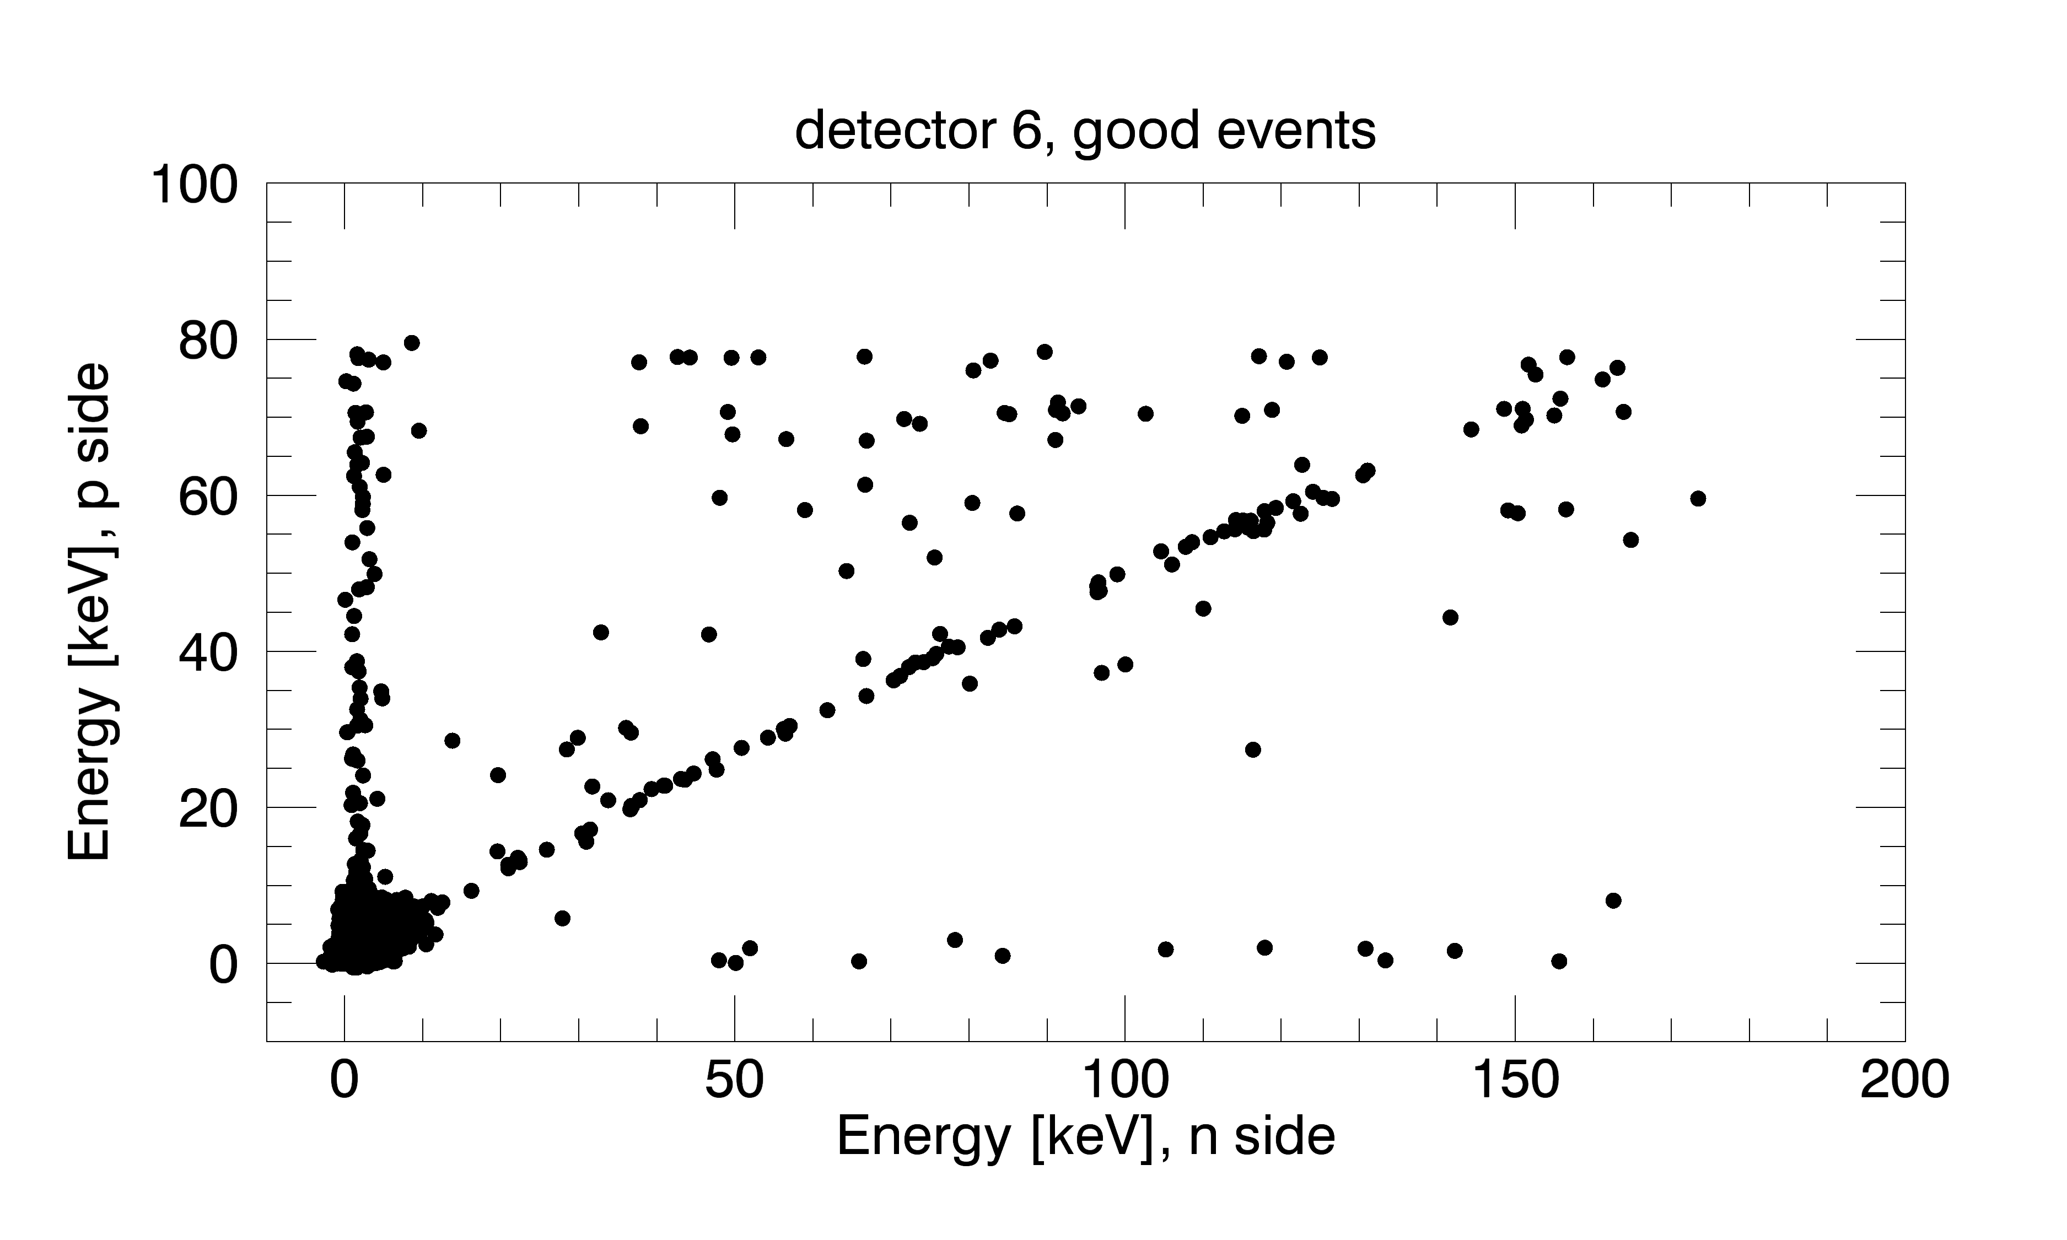
Preliminary level 2 Si data: energy!

Slide 10
Next steps for active region analysis
Immediate next steps for images:
Check what are the error flags to know what are the sources of “bad” events (Sophie)
Try to ignore noisy strips in det 6 data… other ideas? (Sophie)
Do the same kind of analysis for CdTe = need to check the level0 to level1 procedure + geometry (Sophie)
Level 2 data ➔ We have to review our current energy calibration (Sophie and Athiray)
Other next steps for images:
Use statistical analysis to say what is the probability that the counts are randomly distributed (Sophie)
Other next steps for active region analysis:
Lightcurves → time binning and/or kernel density estimation (Sophie?)
Spectroscopy (UMN)

